Slide 1






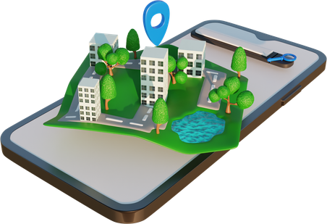

PHOENIX
Team Lead Name : DHARANYA S
Team Lead Contact No.: 9043643264
Selected Theme Hardware Track : IoT for Smart Cities
Project Name : Adaptive Smart Footpath Protection System Using IoT

Slide 2

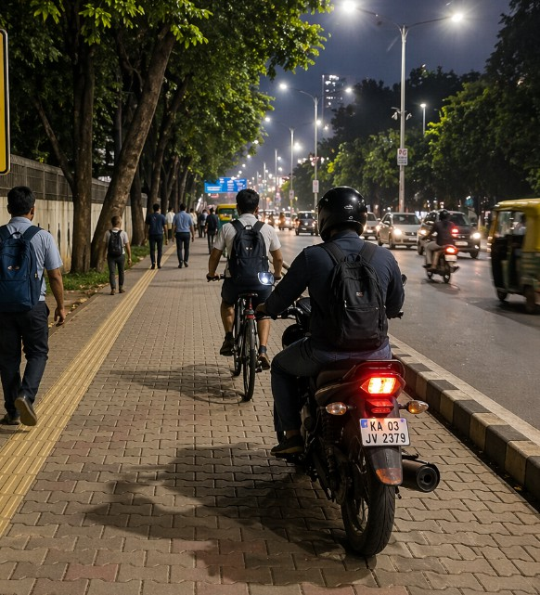



PROBLEM STATEMENT
Footpaths are frequently misused by bicycles and vehicles, making them unsafe for pedestrians
Existing systems lack intelligent classification to differentiate between pedestrians and unauthorized vehicles
Poor lighting conditions during nighttime reduce visibility and increase accident risks
Limited real-time response mechanisms to actively prevent or warn against unsafe intrusions
Insufficient data-driven insights for effective monitoring and improvement of pedestrian safety

Slide 3
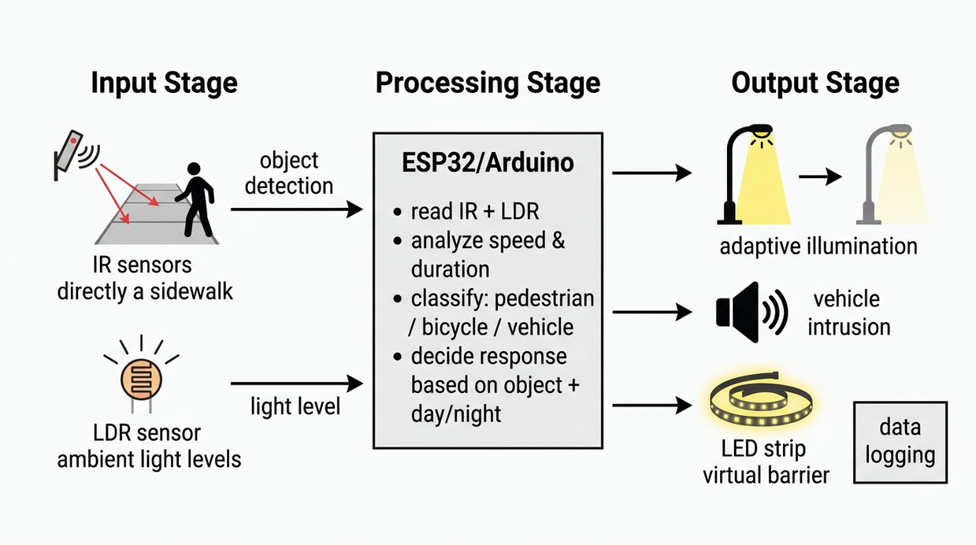
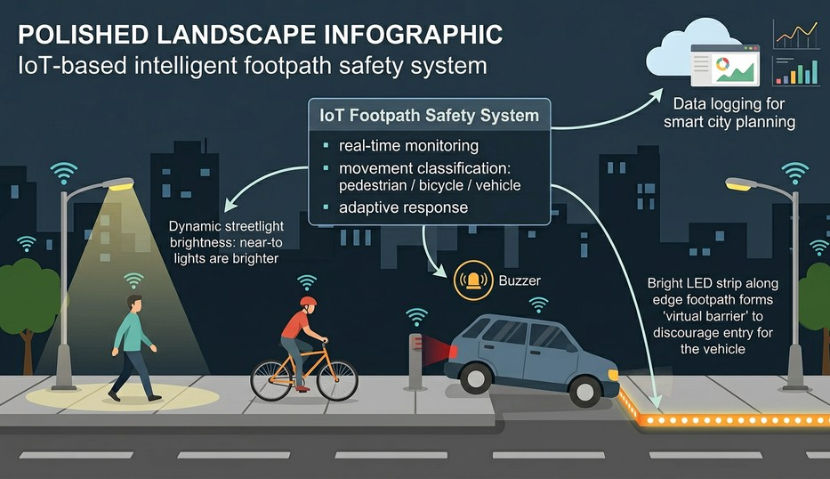
Working Principle
Solution Overview

Slide 4

CORE FUNCTIONALITY
Real-time detection: Continuously monitors the footpath to detect any object entering the area
Intrusion classification: Differentiates between pedestrians and unauthorized vehicles based on movement patterns
Adaptive lighting control: Automatically adjusts brightness based on ambient light and detected activity
Alert mechanism: Triggers buzzer alerts when a vehicle intrudes onto the footpath
Visual warning system: Uses LED indicators to create a “virtual barrier” and signal restricted access
Data logging: Records intrusion events and activity patterns for monitoring and future analysis

Slide 5
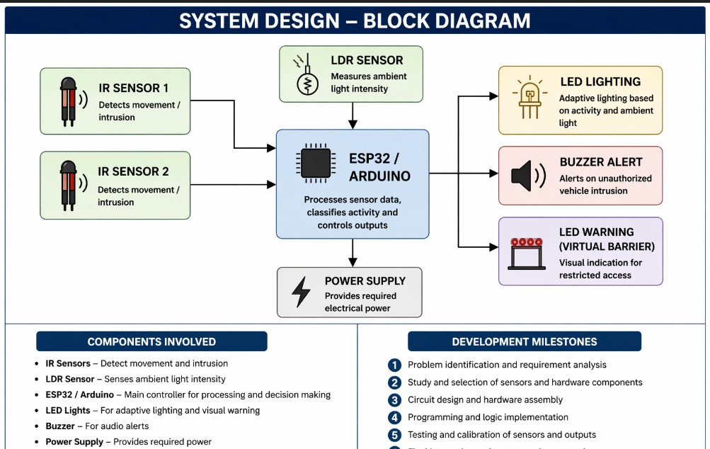
System Desioftn

Slide 6
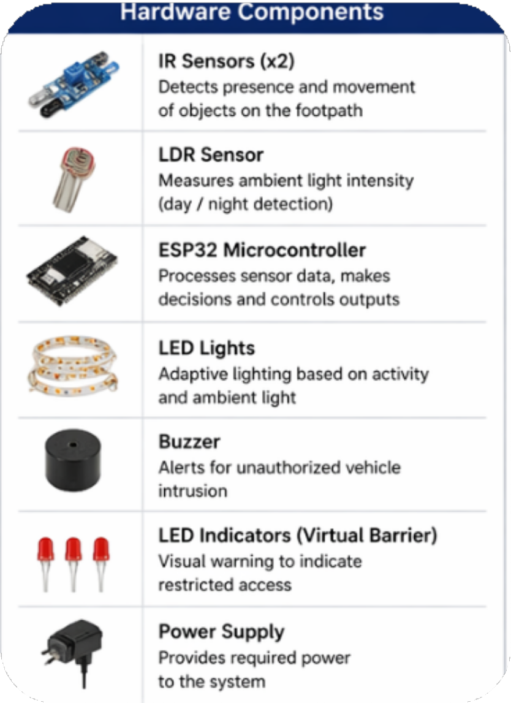
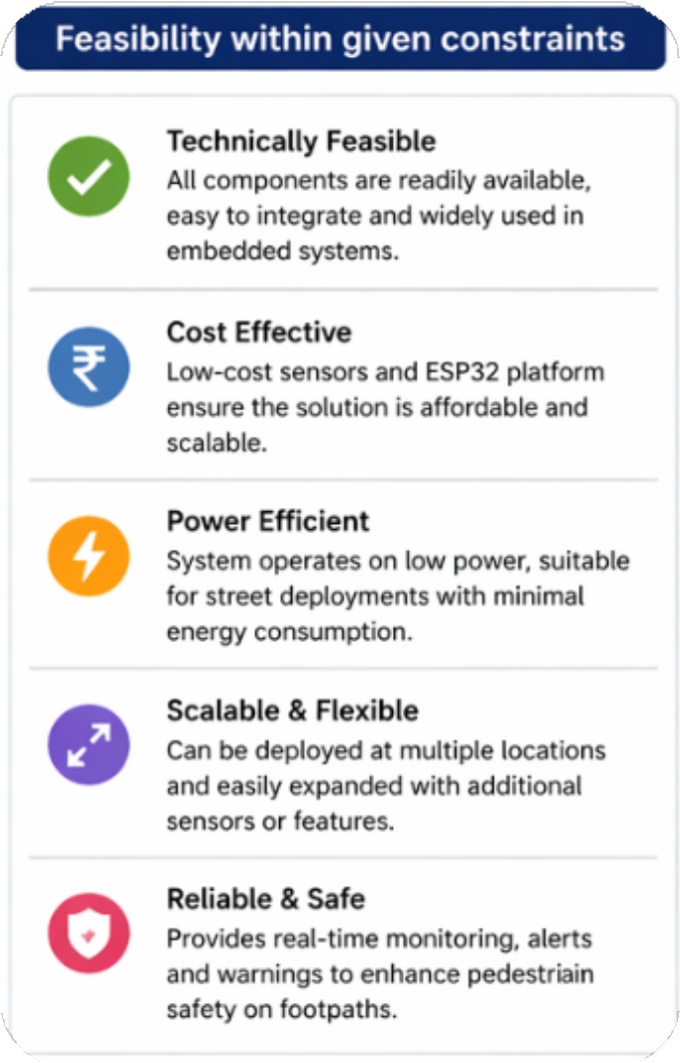
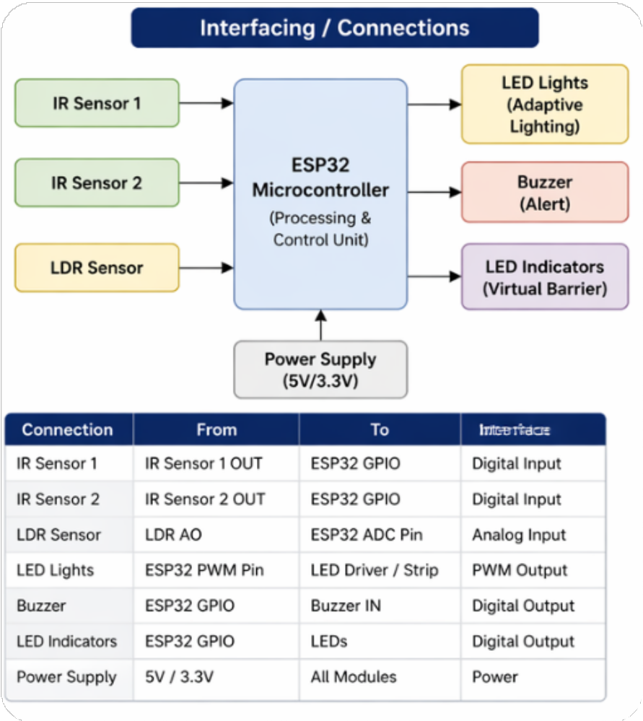

Slide 7




